Slide 1
數位IC設計 Tool安裝&作業模擬教學
NCKU CSIE DICLAB

Slide 2
The simulation process
The simulation process and the necessary tools in this class
The tools can be downloaded from :
https://www.intel.com/content/www/us/en/software/programmable/quartus-prime/download.html#
Functional simulation
Synthesis
Gate Level simulation
ModelSim
Quartus
ModelSim

Slide 3
Download and install Modelsim

Slide 4
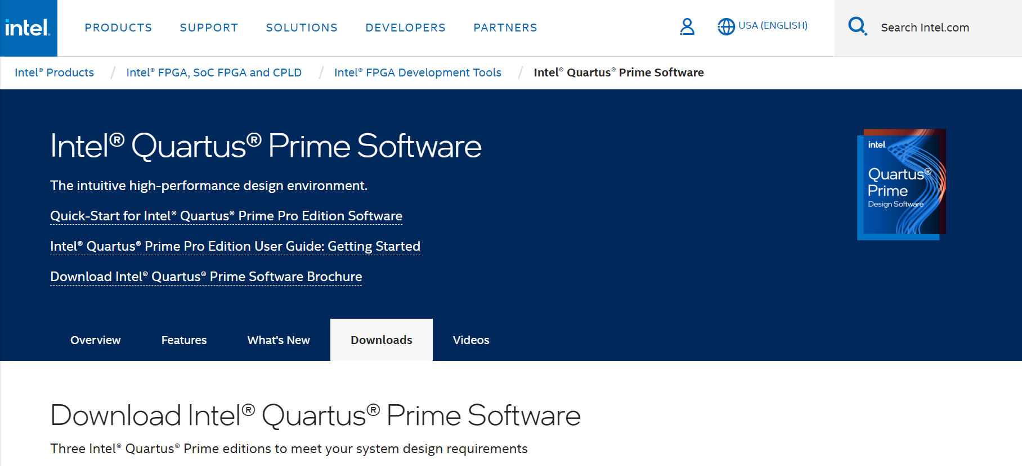
Download and install Modelsim
Step 1: Register and sign in
Click here to create an account and sign in

Slide 5
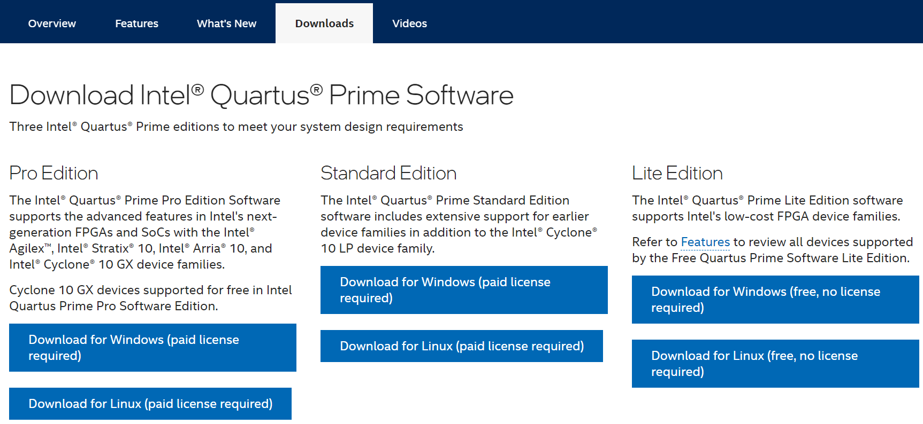
Download and install Modelsim
Step 2: Click “ Download for Windows(free, no license required)“
Click Here

Slide 6
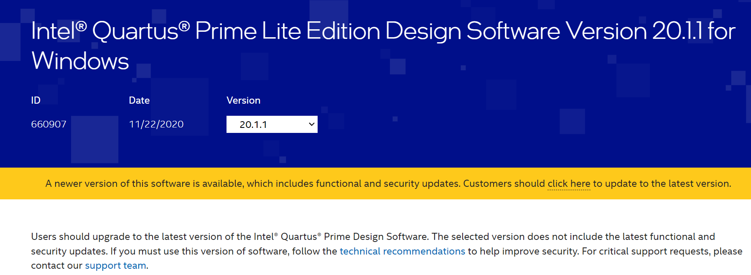
Download and install Modelsim
Step 3: Select software version (20.1.1)
Select version 20.1.1

Slide 7
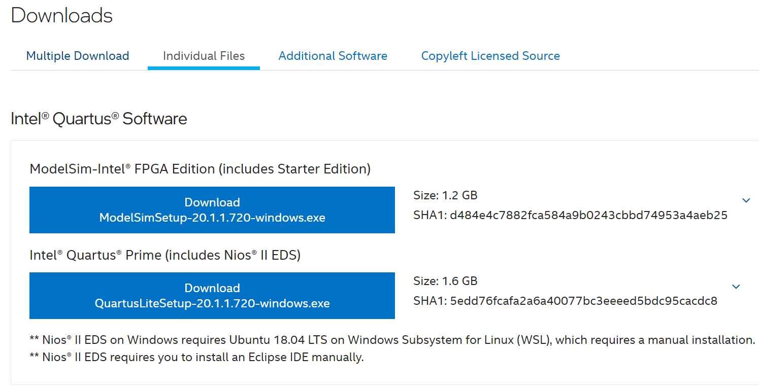
Download and install Modelsim
Step 4: Download Modelsim setup execution file
1. Click the ‘Individual Files’ tab
2. Download Modelsim

Slide 8
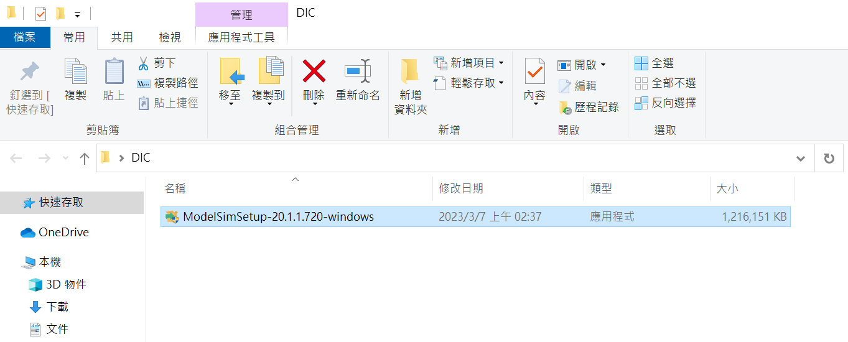
Download and install Modelsim
Step 5: Installation

Slide 9
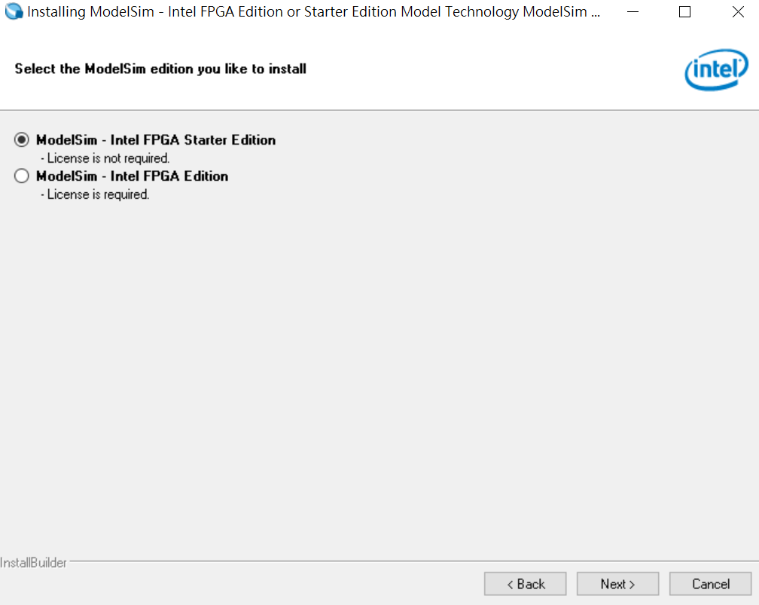
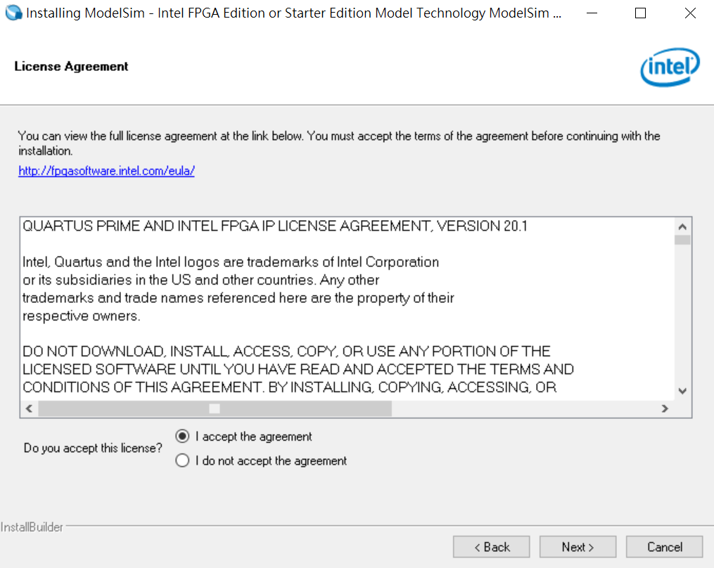
Download and install Modelsim
Step 5: Installation
1. Select starter edition
2. Click
3. Accept the agreement
4. Click

Slide 10
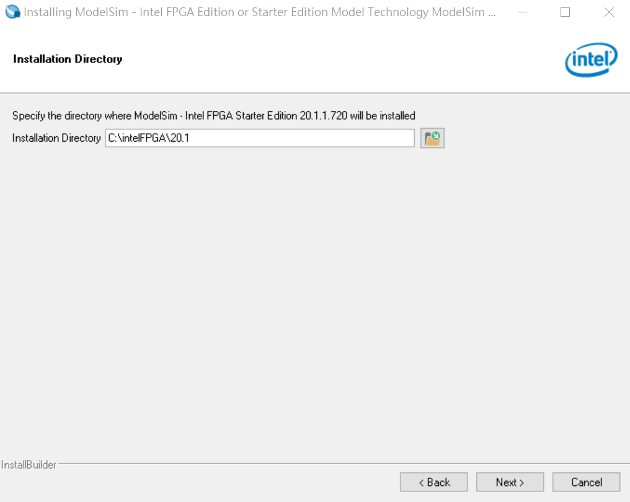
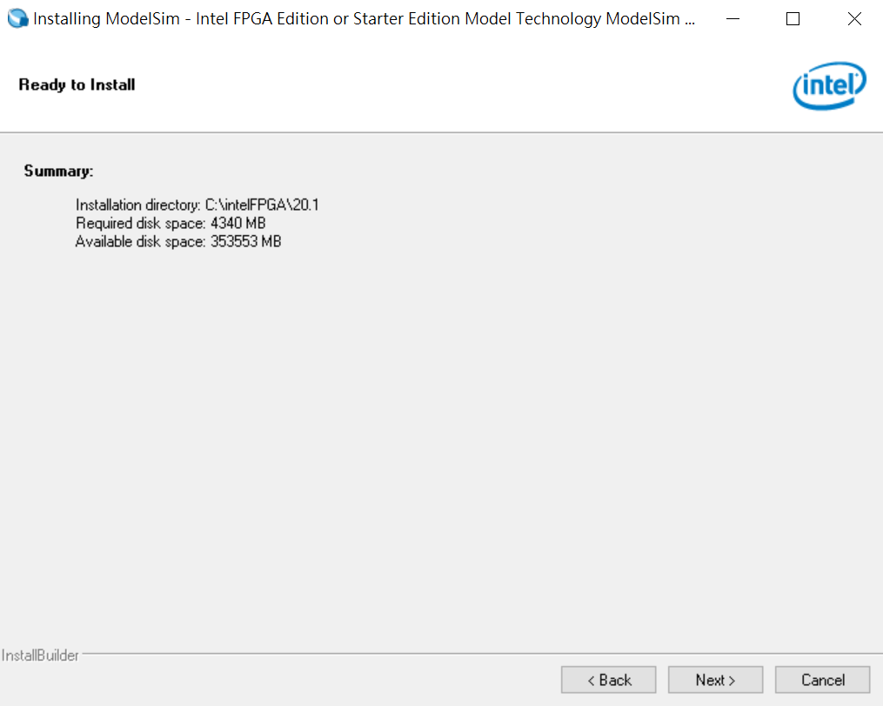
Download and install Modelsim
Step 5: Installation
1. Set installation path
3. Check available disk space
2. Click
4. Click

Slide 11
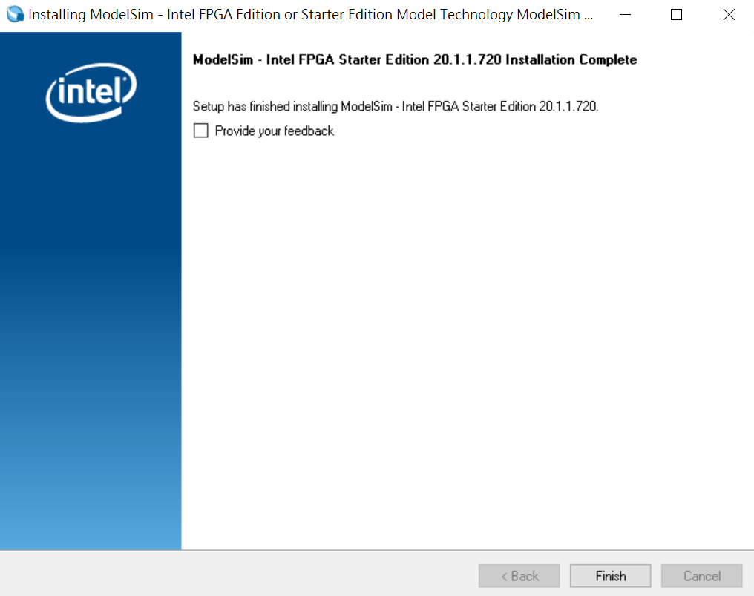
Download and install Modelsim
Step 5: Installation
Click

Slide 12
Functional Simulation by ModelSim

Slide 13
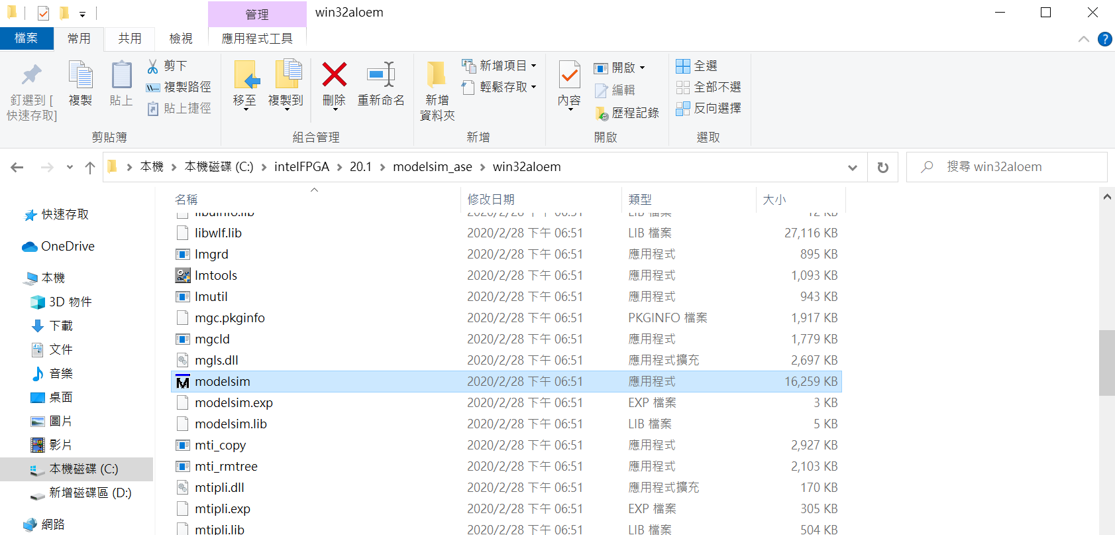
Functional Simulation by ModelSim
Step 1: Run modelsim.exe
Your installation path
Ex: C:\intelFPGA\20.1\modelsim_ase\win32aloem\modelsim.exe

Slide 14
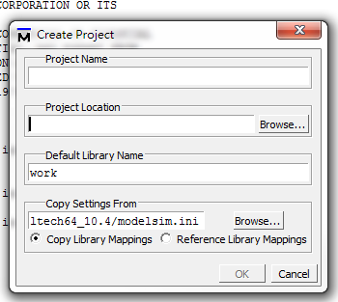
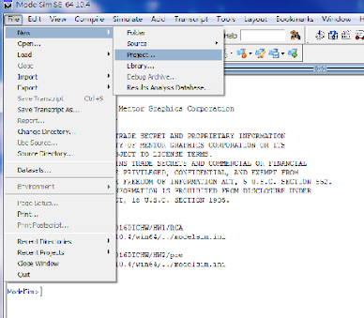
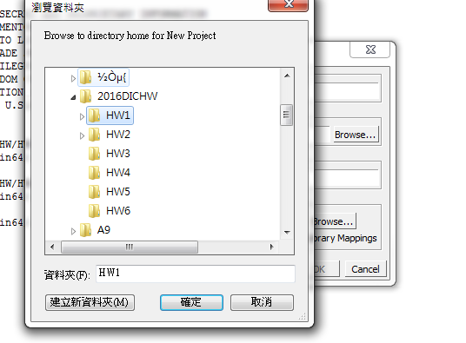
Functional Simulation by ModelSim
Step 2: Create a new project
File -> New -> Project
Click “Browse…”
The name of your project
Click here
The file path should be ALL ENGLISH
The location of your project

Slide 15
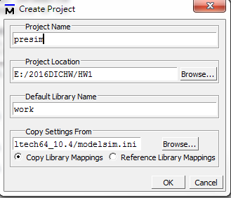
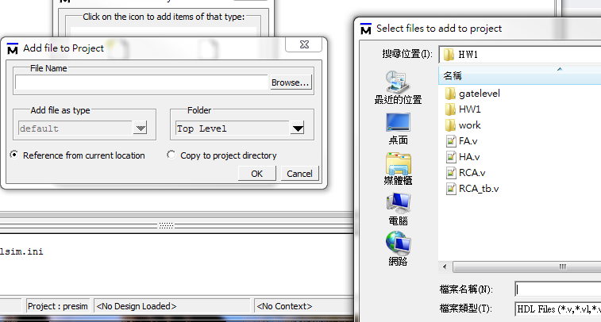
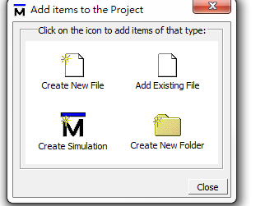
Functional Simulation by ModelSim
Step 2: Add the files
Select all the .v files including the testbench
Verilog code could be stored in any location , “add existing file” would refer to the file location automatically .
Remember to put the test data and golden data at the same directory of the testbench file.
Click here
Click here
Click here

Slide 16
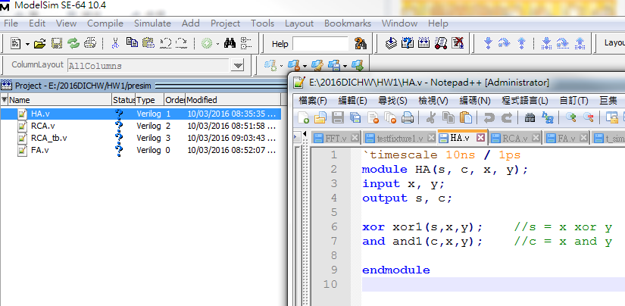
Functional Simulation by ModelSim
Step 3 : Start coding…

Slide 17
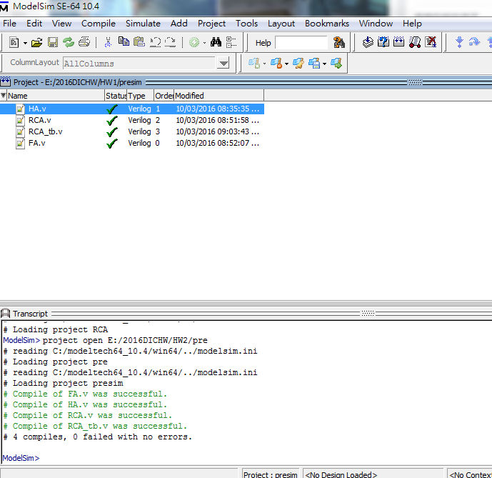
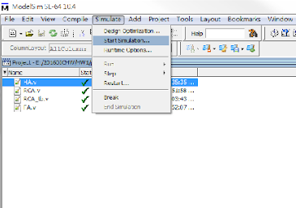
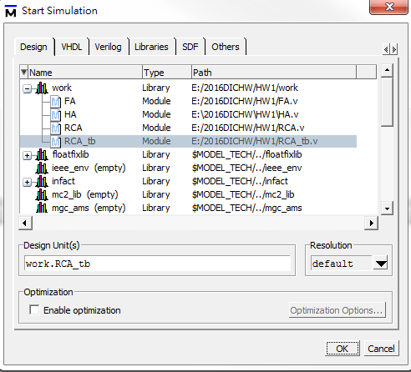
Functional Simulation by ModelSim
Step 4: Compile & Start simulation
Compile -> Simulate -> Start Simulation->work->testbench file
Click here

Slide 18
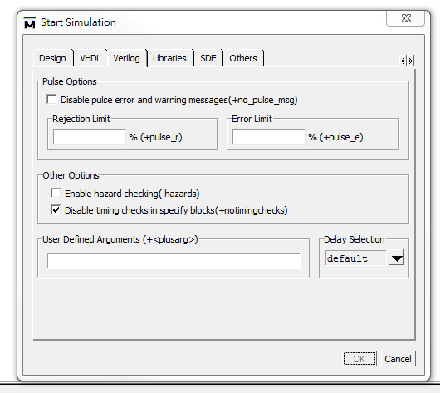
Functional Simulation by ModelSim
Step 4: Start simulation
Check +notimingchecks

Slide 19
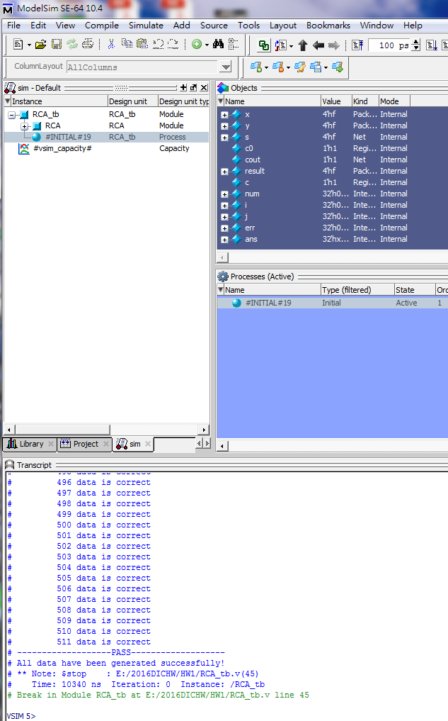
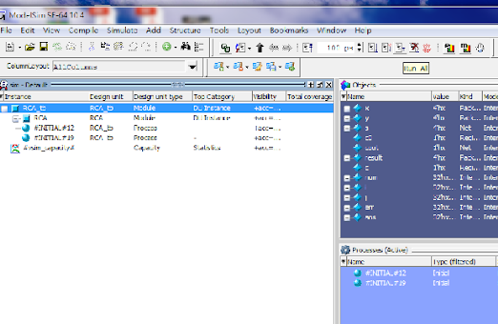
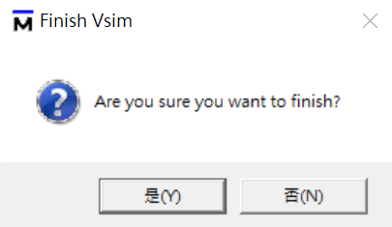
Functional Simulation by ModelSim
Step 5 : Simulation
Click ’Run -All’
Click ’否(N)’
*If you click ’是(Y)’, Modelsim will be closed

Slide 20
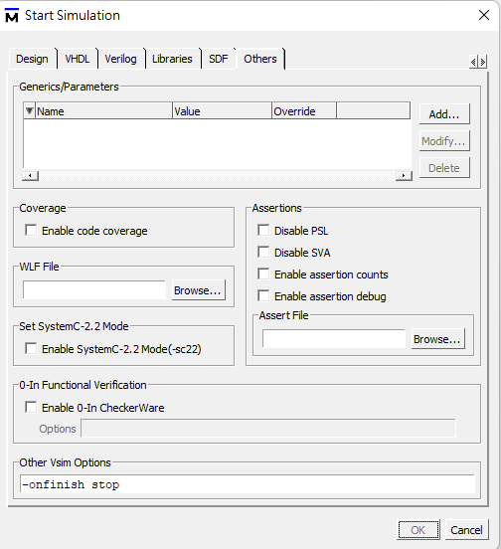
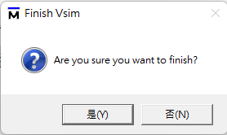
Functional Simulation by ModelSim
Step 5 : Simulation
type “-onfinish stop” in Options (optional)
This will prevent “Finish Vsim” hint dialog from appearing.

Slide 21
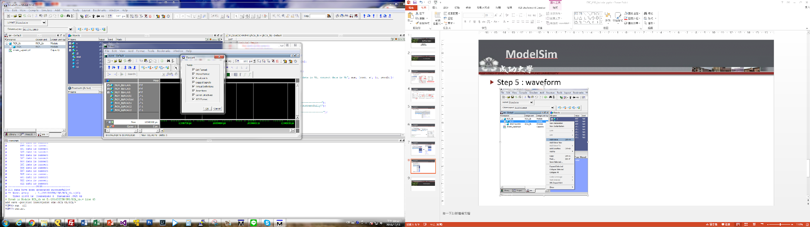
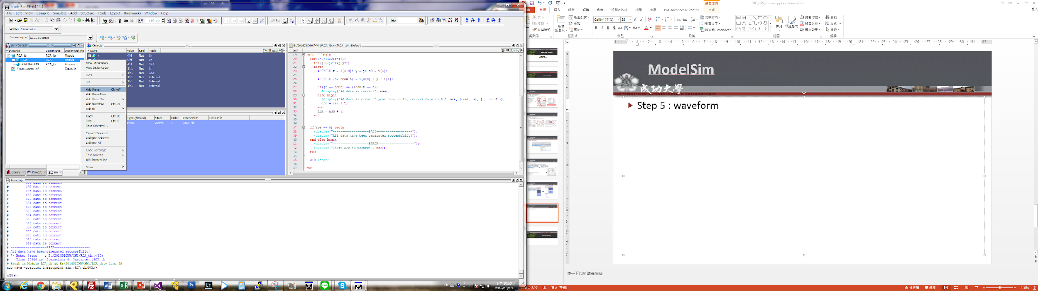
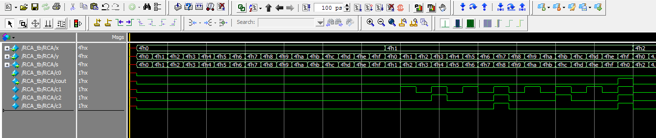
Functional Simulation by ModelSim
You have to “restart” before a new simulation
Step 6 : Show waveform
Click here

